Slide 1
A pipeline for EHR to FHIR conversion

Slide 2
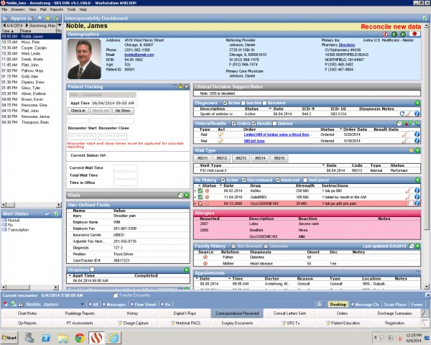
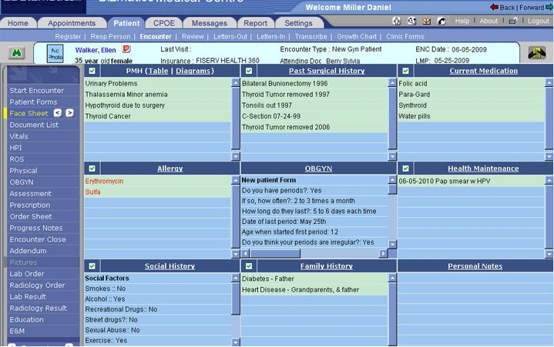

Problem
Heterogenous standards used by EHR companies.
Plugin A
Plugin B

Slide 3

Desirable
Interact directly with a single standard.

Slide 4

Middleware
Interacting with a single standard is a long term goal, instead we look to middleware that is designed to sit in front of each vendor’s system.
However this middleware says little about how conversion to the common standard is to take place. As such, this is typically defined manually for each standard.

Slide 5
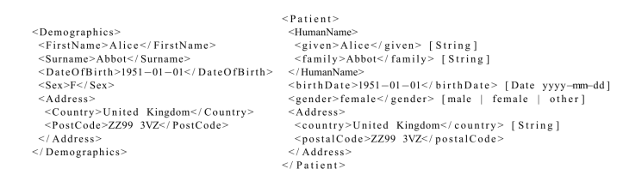
Relevant existing work
Identifying techniques that are relevant for automatically matching the elements of different schema, and thus mapping between EHR standards and FHIR:
Fine grain NLP techniques: text similarity, morphological similarity, semantic similarity.
Coarse grain NLP techniques: composite word similarity.
Structural similarities.

Slide 6
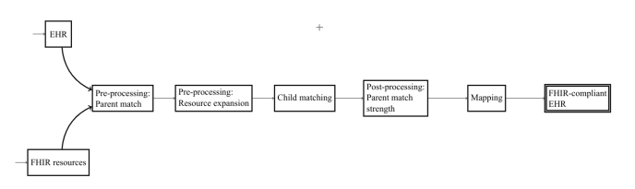
Approach
Combining, sequencing and configuring these techniques into a transformation pipeline.

